Slide 1




PROBLEM SOLVING PROCESS
Class X
lab 6

Slide 2
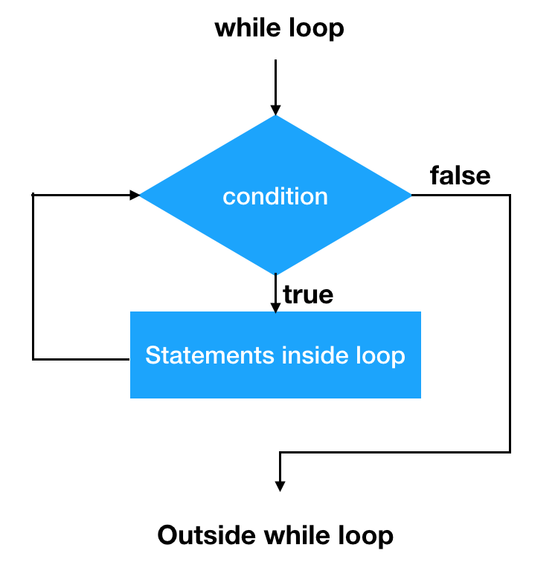
While Loop
a while loop is a control flow statement that allows code to be executed repeatedly based on a given Boolean condition

Slide 3
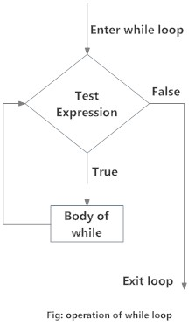
Flowchart of while Loop

Slide 4
Example: while Loop
# Program to add natural # numbers upto # sum = 1+2+3+...+n # To take input from the user, # n = int(input("Enter n: ")) n = 10 # initialize sum and counter sum = 0 i = 1 while i <= n: sum = sum + i i = i+1 # update counter # print the sum print("The sum is", sum)

Slide 5
while loop with else
Same as that of for loop, we can have an optional else block with while loop as well

Slide 6
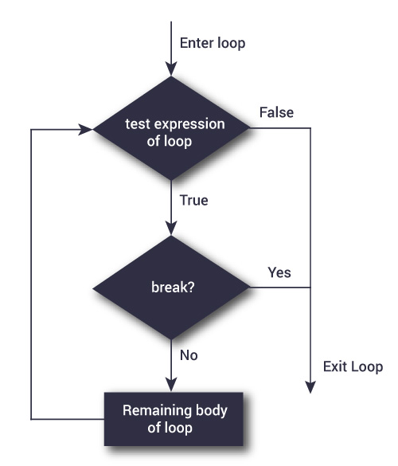
Flowchart of break

Slide 7
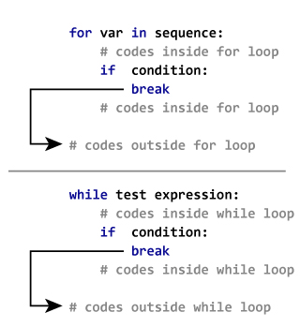
Make a Toast

Slide 8



